Slide 1
Presentation

Slide 2
Topic: Working Procedures to find the Inverse of matrix.
Course Code : Math-1231
Course Title : Mathematics-II

Slide 3
Name :Sajib Bhattacharjee ID:20201070010 Semester:1.2 Section: B Department of Computer Science and Engineering Date: 10.10.2020
North Western University , Khulna.

Slide 4
INVERSE MATRIX
As usual the notion of inverse matrix has been developed in the context of matrix multiplication . Every nonzero number possesses an inverse with respect to the operation ‘number multiplication’
Definition: Let ‘M’ be any square matrix . An inverse matrix of ‘M’ is denoted by ‘𝑀−1 ’ and is such a matrix that 𝑀𝑀−1= 𝑀−1𝑀=𝐼�
Matrix ‘M’ is said to be invertible if 𝑀−1 𝑒𝑥𝑖𝑠𝑡𝑠. Non-square matrices do not have inverses.
Note:
Not all square matrices have inverses. A square matrix which has an inverse is called invertible or nonsingular, and a

Slide 5
Working Procedure :
Step-1: Find the determinant of M
Step-2: Find the cofactor matrix
Step-3: Find the transpose of cofactor matrix
Step -4: M⁻¹ = 1/|M| (Result of step-3 )

Slide 6
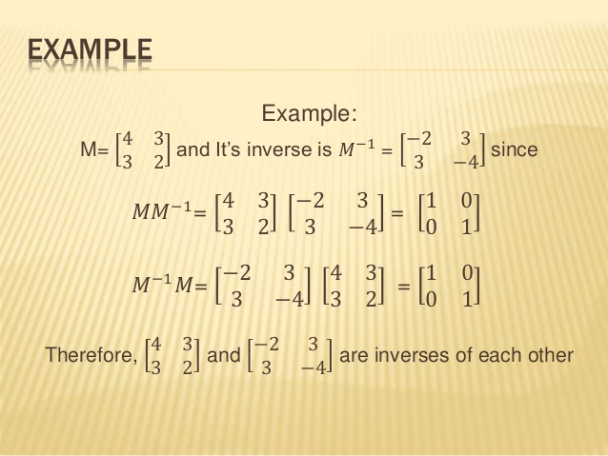

Slide 7
Thank You

